Slide 1
Presentation: 24-BIT CPU DESIGN

Slide 2
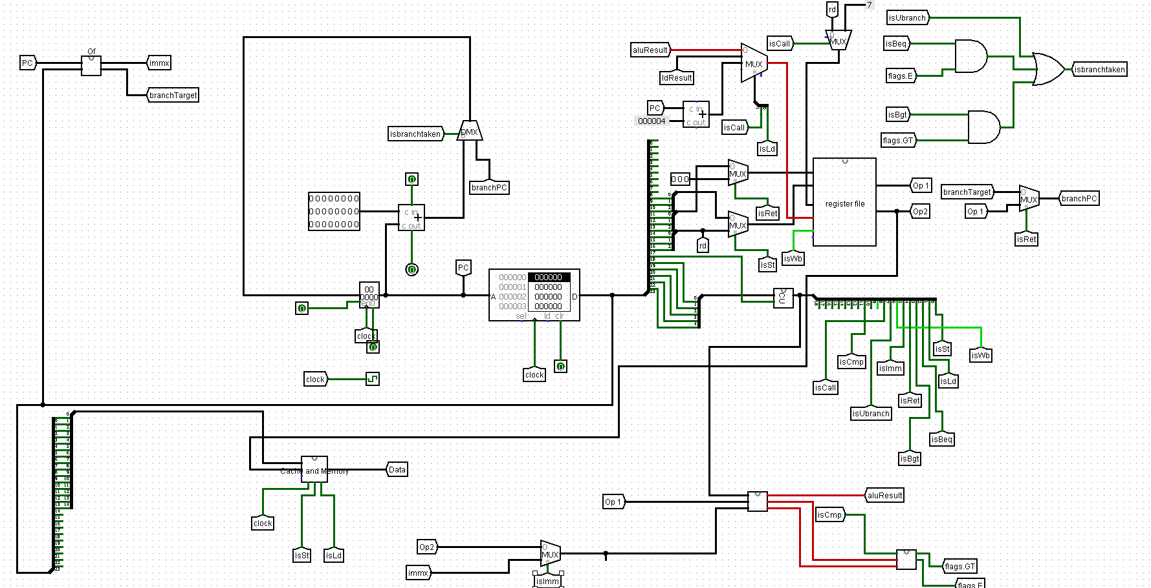

Slide 3

Instruction Fetch (IF)
The first stage of the instruction processing cycle
It performs two tasks: 1. Fetch the instruction from the RAM 2. Find the address of the next instruction to be processed
These tasks are done with the help of an important register: the Program Counter which acts as the storage unit of the address of the instructions to be processed
The next instruction’s address to be fetched is done with the help of a demultiplexer since even branch instructions can be present

Slide 4
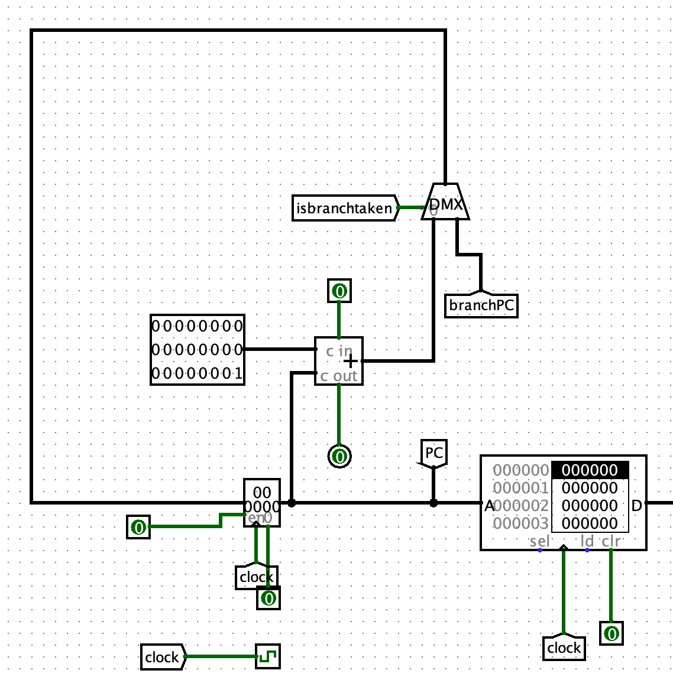
The IF Circuit

Slide 5
The Program Counter (pc)
The program counter is a register (24-bit) which is used to store the addresses of the instructions to be processed
As soon as the current instruction goes on to the execute stage, the program counter gets modified for which a demultiplexer is used
The pc register

Slide 6
The Demultiplexer
Demultiplexer
The demultiplexer (marked in the figure) is used to store the address of the next instruction based on isbranchtaken as control signal
In case isbranchtaken is: 0 : current pc + 1 is the address of the next instruction 1 : branchPC is taken as address of the next instruction. This happens in case of the instrcution being a branch instruction
For calculating current pc + 1, an adder is used
Adder

Slide 7
Operand Fetch Unit
Operand Fetch and EX Stage

Slide 8
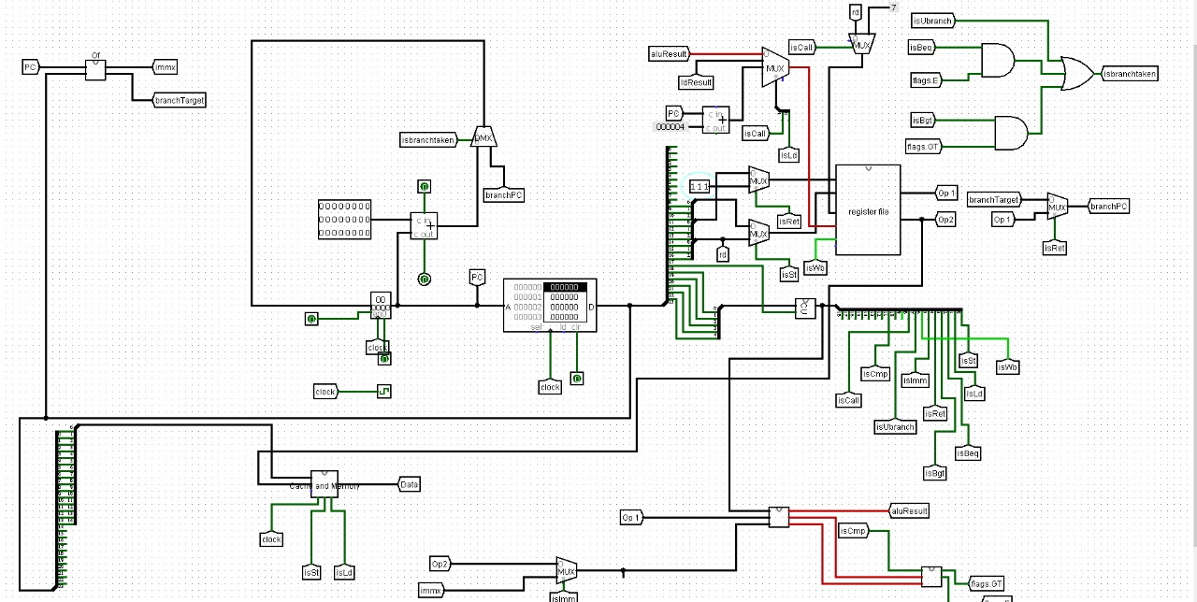
Operand Fetch
Immediate and Branch Calculate
EX Stage

Slide 9
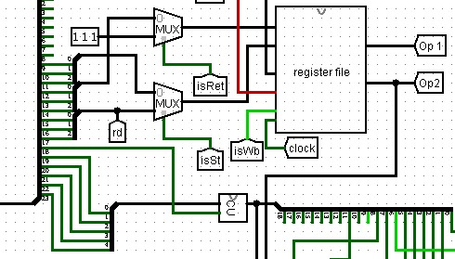
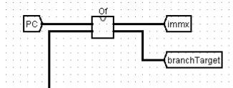
Operand Fetch Unit
Register File Read
Immediate and Branch Unit
Instruction

Slide 10
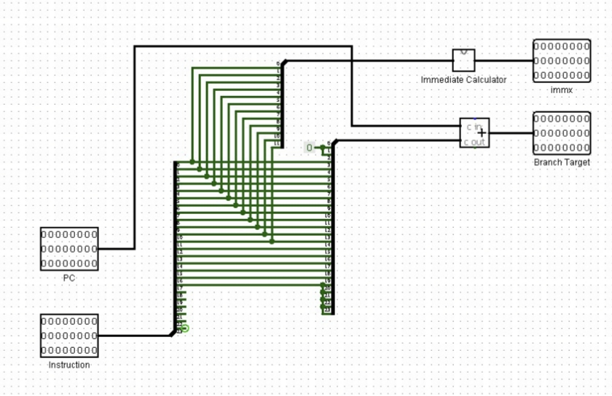
Operand Fetch Unit
Immediate and Branch Unit
Inputs : 24 bit instruction and PC
Outputs : Extended Immediate value and calculated branch target
Immediate Calculator uses modifier bits to extend the immediate value and outputs 24 bit immx
Branch Unit shifts the 19 bits (18-0) by 2 bits to make it 21 bits and then extends it to 24 bits with sign.
Then adds PC to it to calculate the branch target address

Slide 11
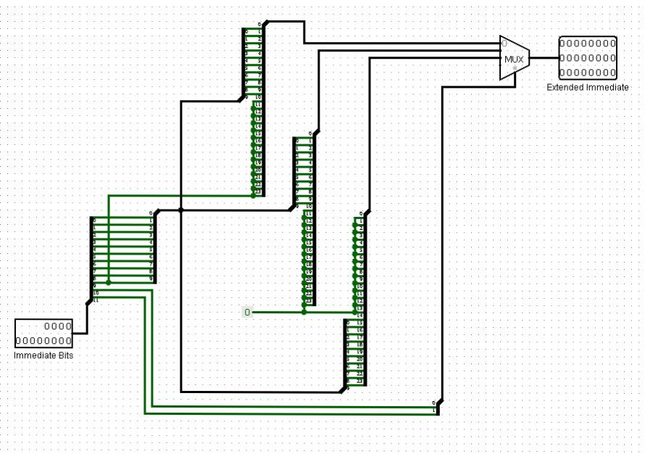
Operand Fetch Unit
Immediate Calculate
This takes the 12 bits (2+10) of immediate from the 24 bit instruction and calculates the extended immediate value according to the 2 modfier bits
Uses MUX with modifier bits as select bits.
00 – extends to 24 bits with sign
01 – extends to 24 bits treating unsigned
10 – shift the 10 bits to MSB (23-14) and set remaining to 0

Slide 12
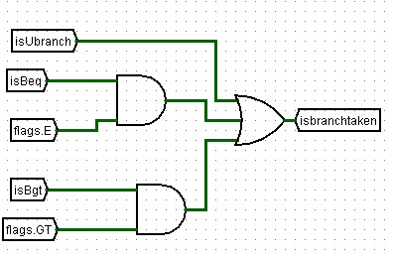
EX Stage – Branch Unit
Generates the isBranch taken signal
Checks :
If unconditional branch instruction
If branch-if-equal instruction is given and flag.E is also set to 1
If branch-if-greater instruction is given and flags.GT is also set to 1
For these conditions, it outputs 1 otherwise a 0

Slide 13
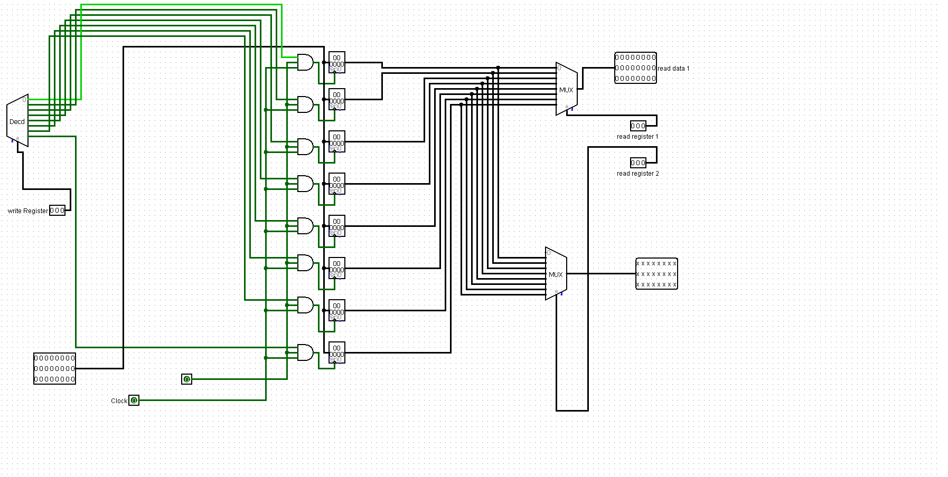
After the address of the required registers is received from decode stage these are passed into the register bank where using multiplexers we get the values in the registers that we want to access . These values are Op1 and Op2.

Slide 14
Control Signals

Slide 15
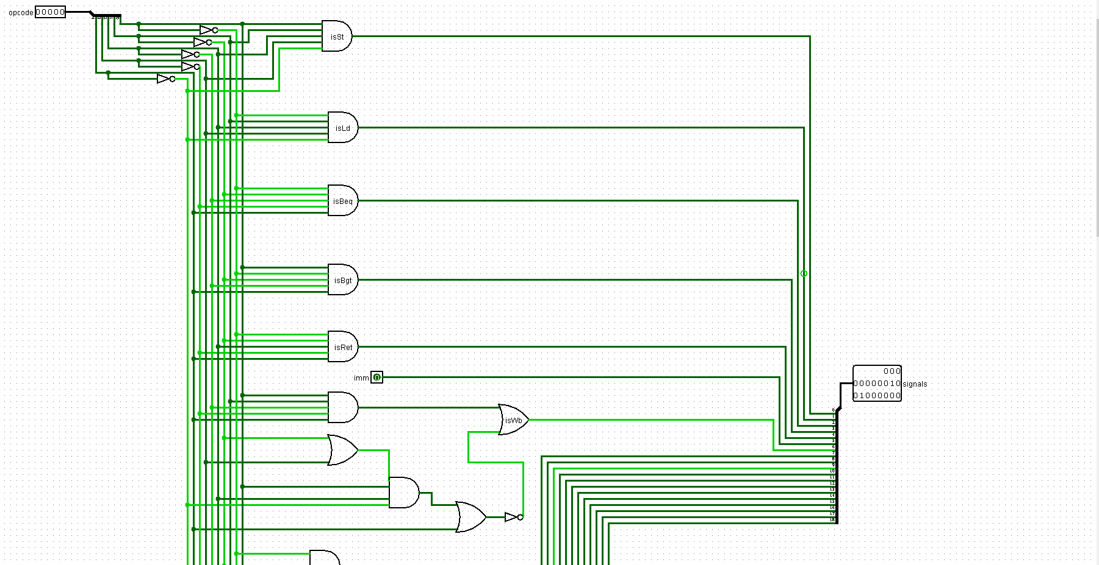
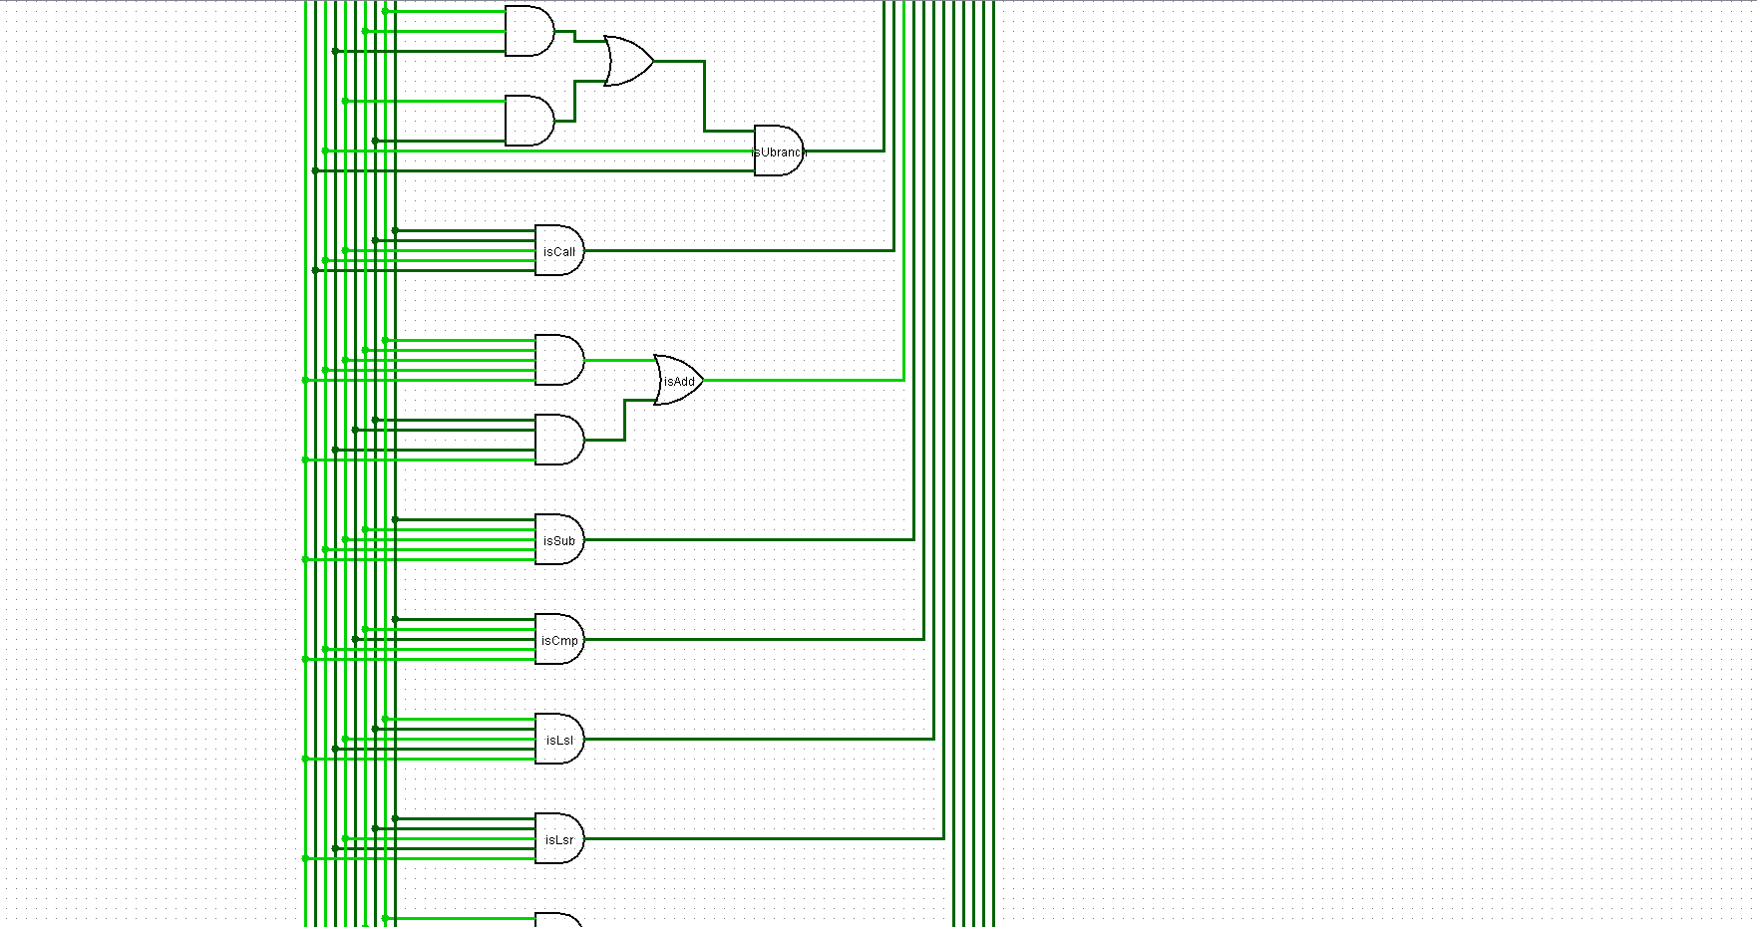
Control Signals are generated using logic gates which help in making decisions in the working of processor as in deciding which operation to perform and when.

Slide 16
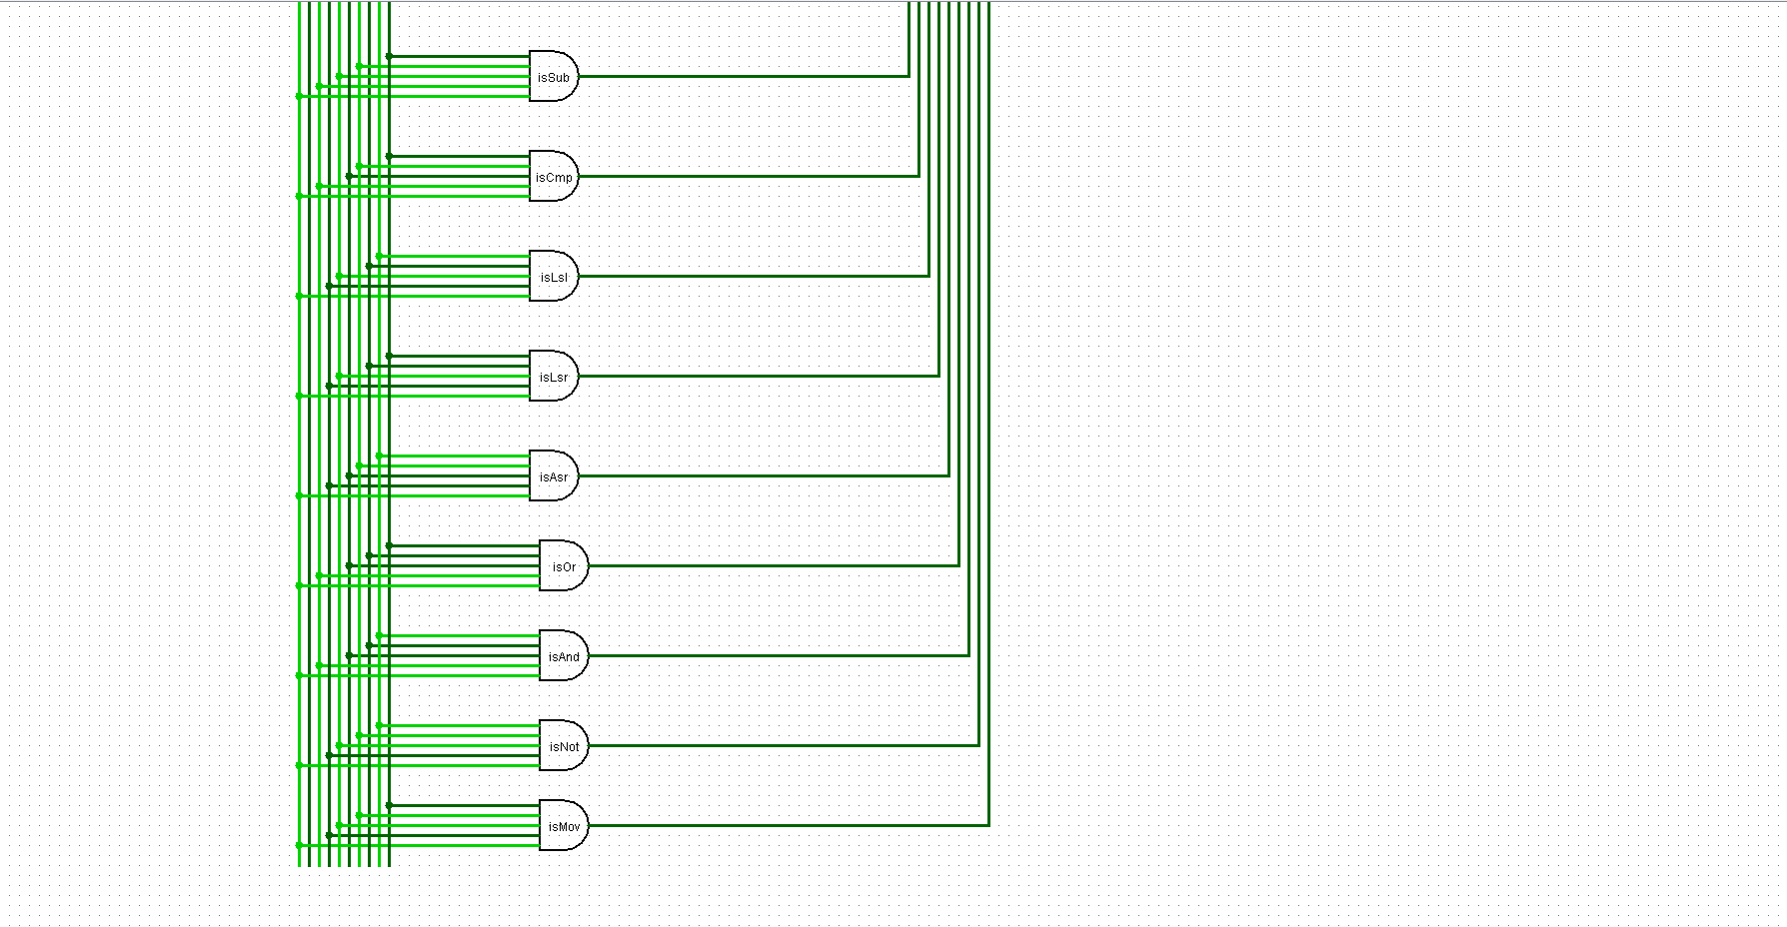
There are 19 different control signals which are generated and these correspond to different operations such as ALU operations, branch operations, checking immediate , return , call etc.

Slide 17
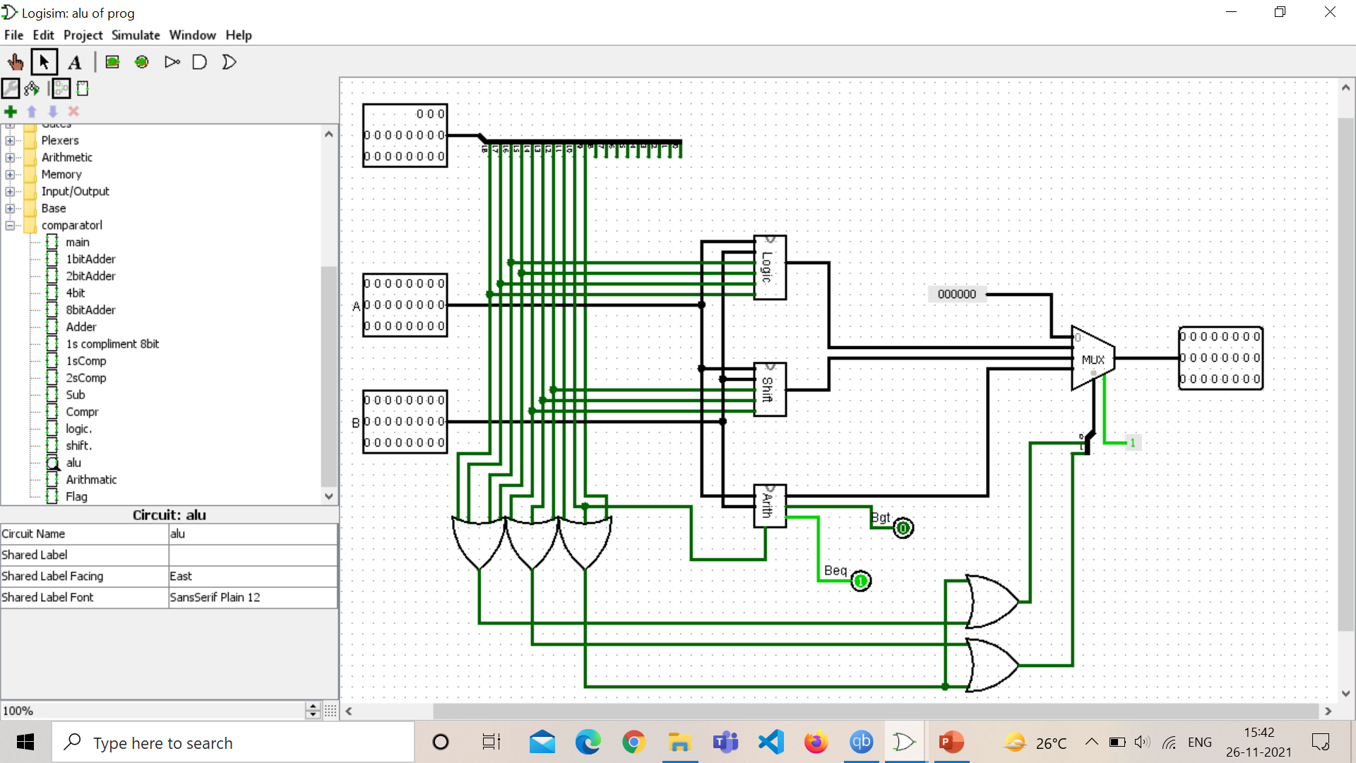
ALU (Arithmetic Logic Unit)

Slide 18
Input – Two operands and control signals Output – beq, bgt and AluResult Divided into three parts: a) Logic b) Shift c) Arithmetic

Slide 19
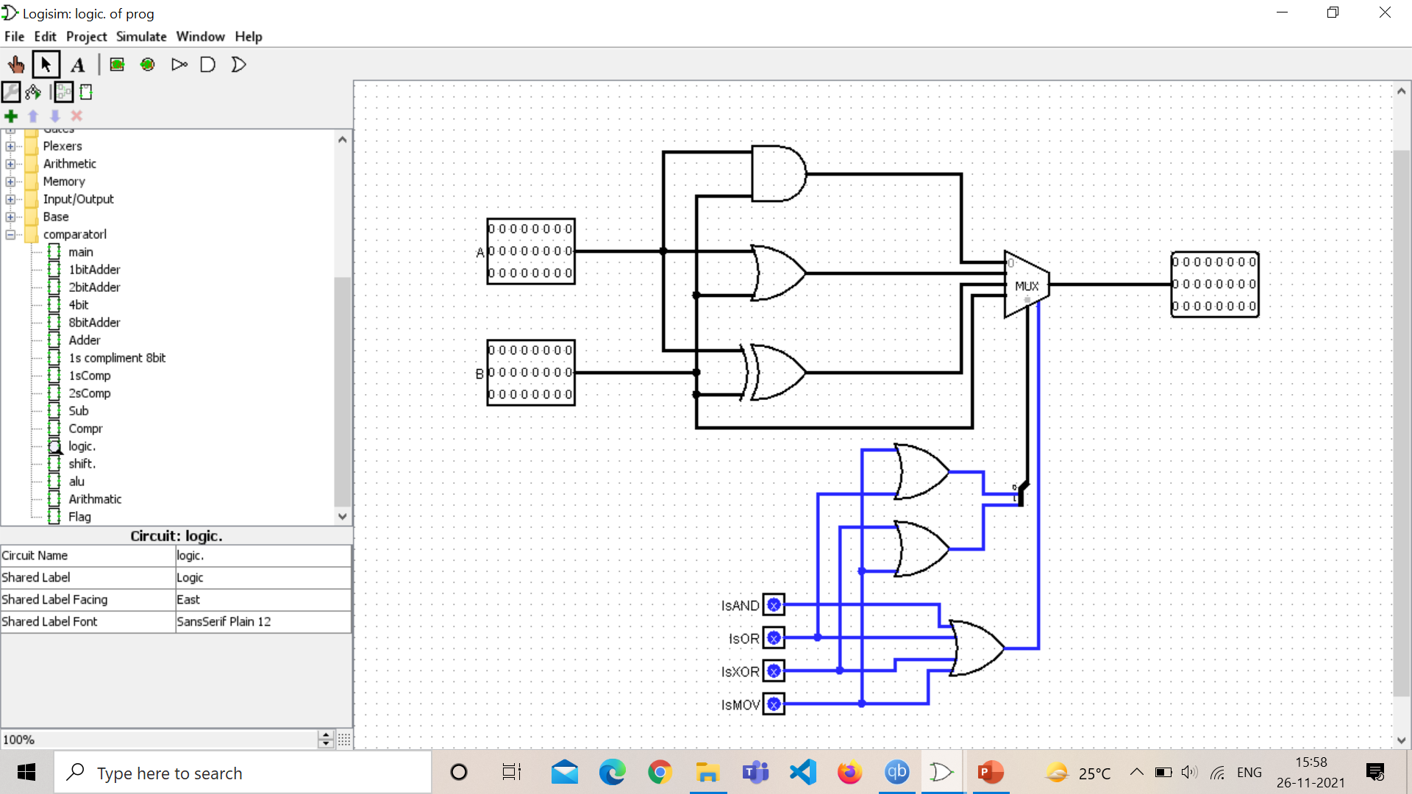
Logical Unit

Slide 20
Input – Two operands and control signals Output – LogicResult Consists of 4 operations: a) AND b) OR c) XOR d) MOV

Slide 21
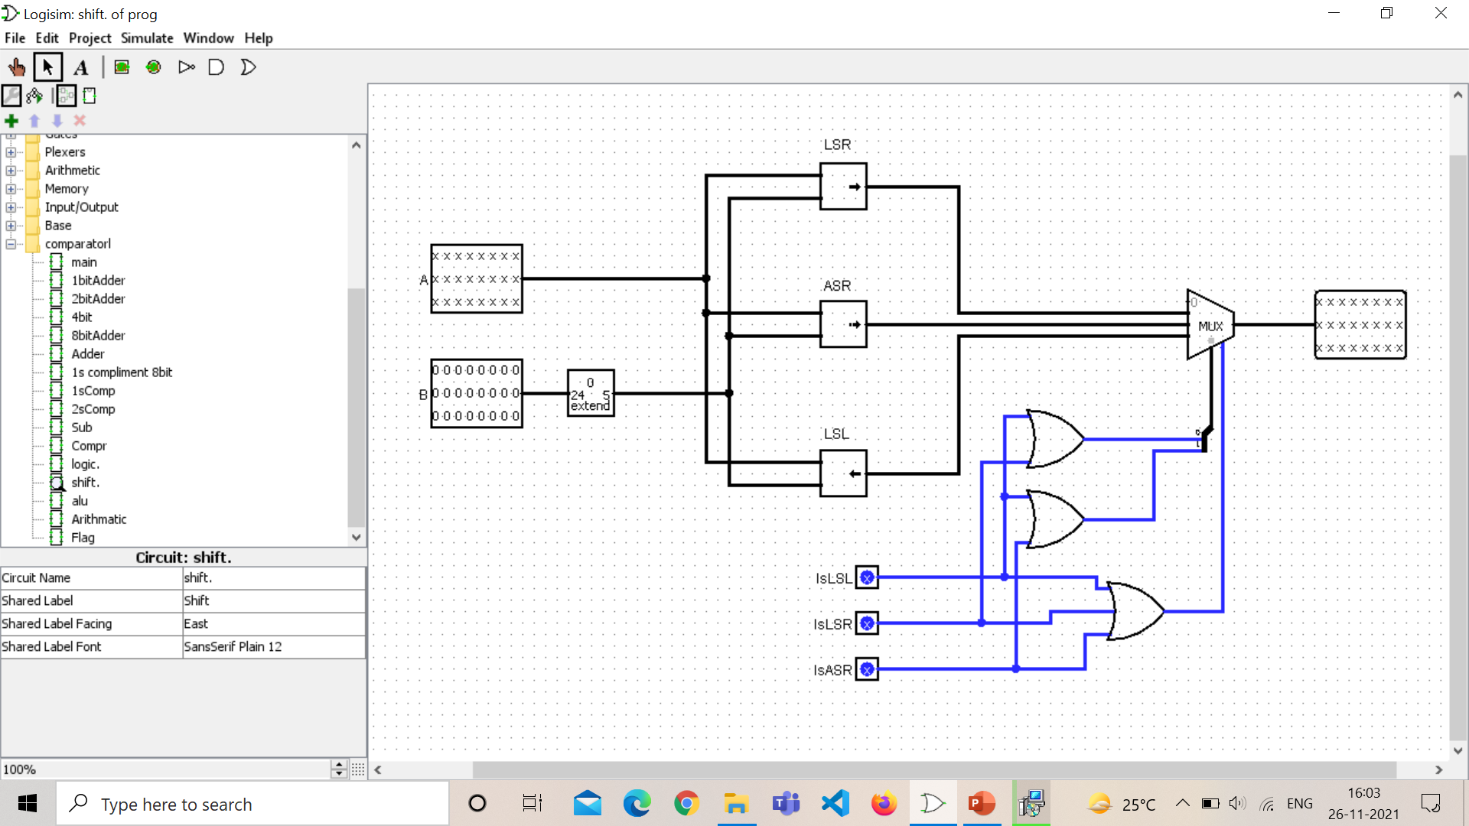
Shift Unit

Slide 22
Input – Two operands and control signals Output – ShiftResult Consists of 3 operations: a) LSL (Logical Shift Left) b) LSR (Logical Shift Right) c) ASR (Arithmetic Shift Right)

Slide 23
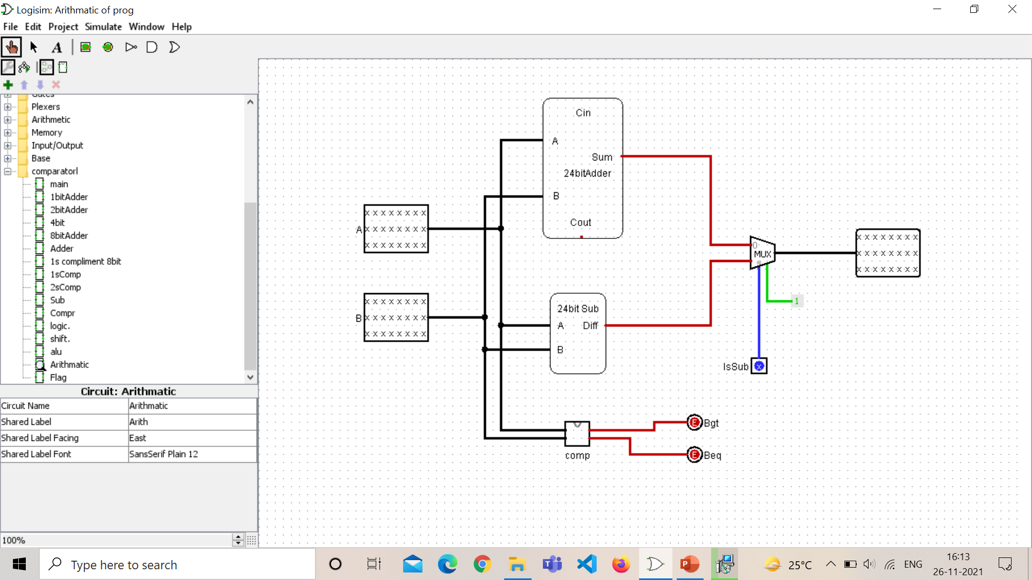
Arithmetic Unit

Slide 24
Input – Two operands and control signals Output – ArithmeticResult and beq, bgt Consists of 3 operations a) ADD b) SUB (Subtract) c) CMP (Compare)

Slide 25
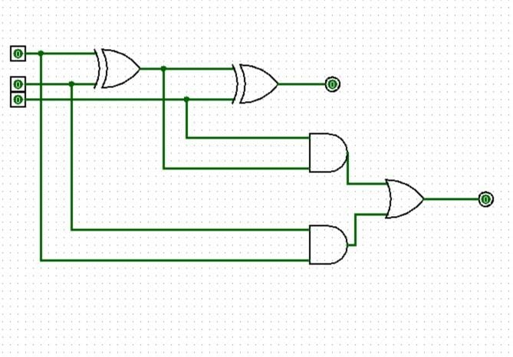
24 bit adder :
1 bit full adder :
To find the sum of A,B and Cin we take XOR of A,B and Cin.
To find Cout of this full adder we implement the following expression: ((A⊕B).Cin)+(A.B).
Inputs are three 1 bit numbers.
Output is Carry and Sum as 1 bit numbers.

Slide 26
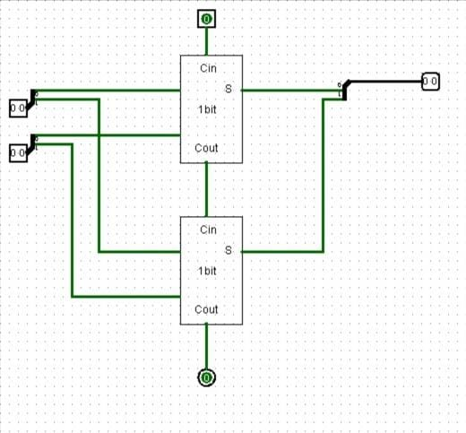
2 bit adder with carry:
We implemented this circuit by connecting two 1 bit adders together.
We have a Cin for the circuit at the top and Cout for first 1 bit adder feeds into the Cin of second 1 bit adder as carry.
We use splitters to split the 2 bit input pin into respective bits for the operation.
Final output is the sum as 2 bits with a final carry Cout.

Slide 27
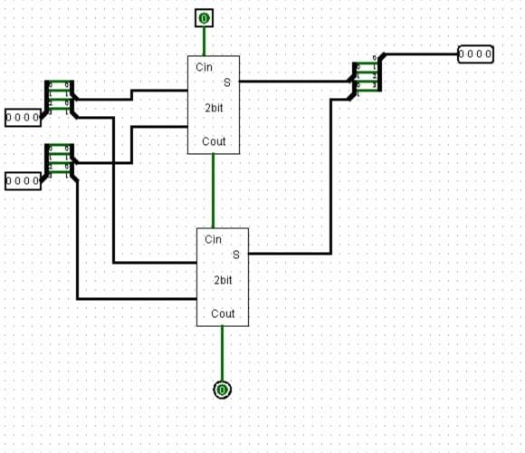
4 bit adder with carry:
We implement this circuit by utilising two 2 bit adders in consecution.
The top 2 bit adder has an input carry 0 and the Cout from top adder feeds to the next adder as Cin.
Final output is produced in the form of 4 bit sum along with 1 bit carry.

Slide 28
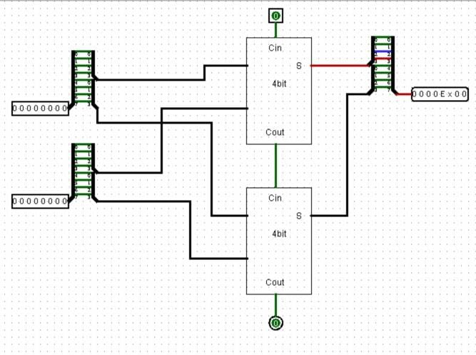
8 bit carry with adder:
We implement this circuit by making use of two 4 bits adder.
Input of this circuit is 2 four bit inputs to be added and Cin to add the carry.
Output is produced in the form of a 4 bit sum along with a single bit carry.

Slide 29
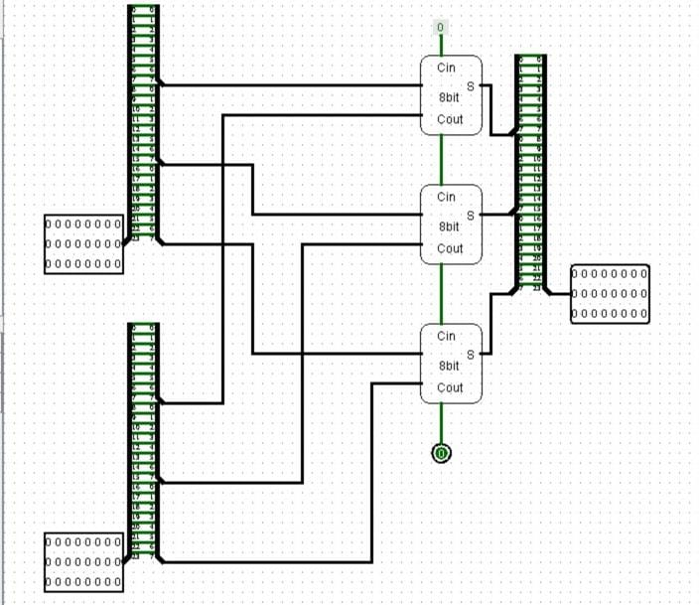
24 bit adder with carry:
To implement this circuit we utilise three 8 bit adders in consecution.
These adders daisy chain and Cout for adder feeds as Cin to the next circuit.
Input here is two 24 bits numbers to be added and a constant Cin as 0.
Output here is 24 bit sum and 1 bit carry.

Slide 30
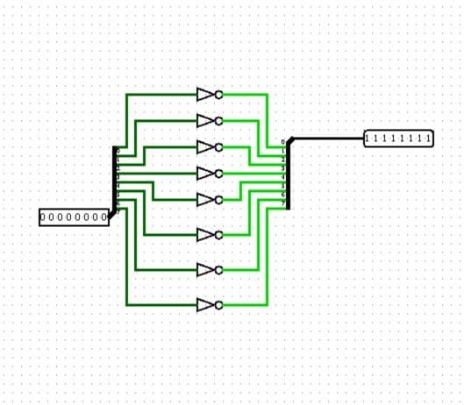
1s complement for 8 bits:
In this circuit we have an 8 bit input which is split into corresponding bits by utilising a splitter.
Each bit is complemented using a NOT gate.
Final output of this circuit is an 8 bit complement of the input.

Slide 31
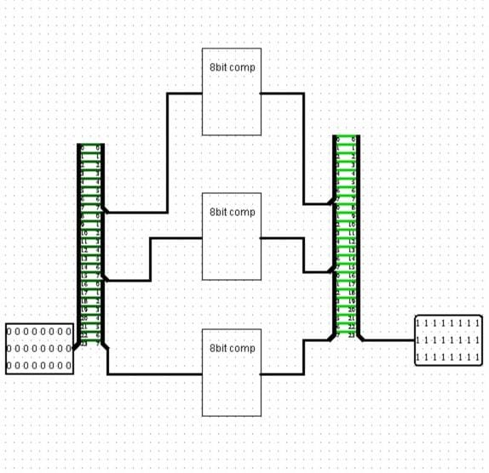
24 bits 1s complement:
In this circuit we utilise three 8 bits complementors to get our 24 bit 1s complement.
Input is 24 bit number.
Output is the 24 bits 1s complement of the corresponding input.

Slide 32
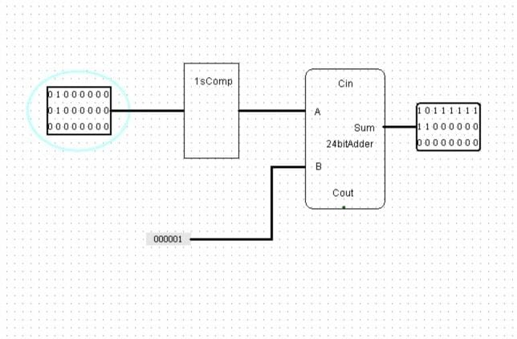
2s complement for 24 bits:
For this circuit we implement our 2s complement by first finding 1s complement of our 24 bit input which in turn is fed to our already created 24 bit adder along with 0x000001(hexadecimal) as inputs to obtain the required 2s complement of our 24 bit input.

Slide 33
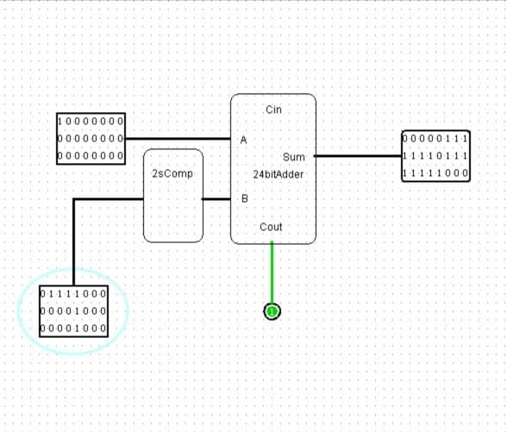
24 bit subtractor:
For this we pass the first input directly to the 24 bit adder and the second input is the 2s complement of the number to be subtracted.
The output is the corresponding 24 bit difference.

Slide 34
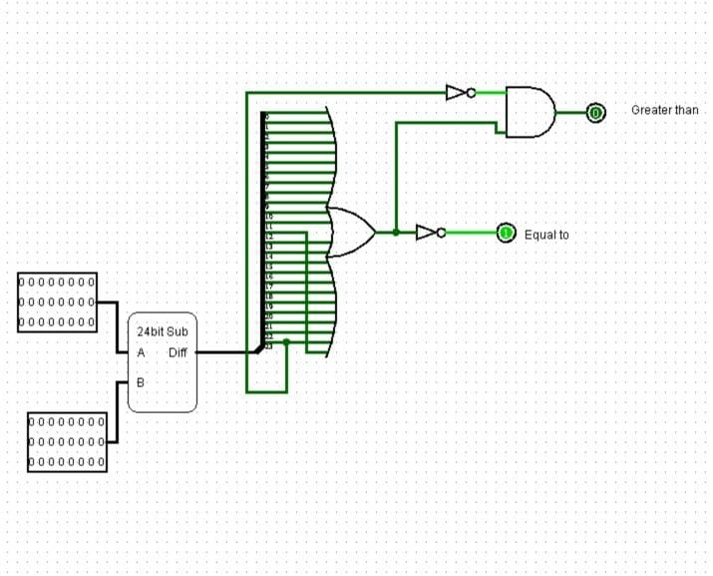
24 bit comparator:
In this circuit two flags are the outputs i.e. greater than flag and equal to flag.
We pass both the 24 bit inputs through our 24 bit subtractor and if the difference is 000000(hexadecimal) then the equal to flag is 1.
Otherwise, when the difference is not 000000 and the most significant bit of the difference is 0 then greater than flag is triggered.

Slide 35
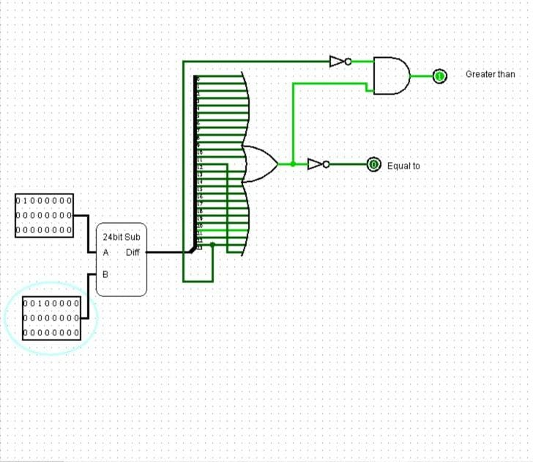
In the previous case of the circuit both values were equal hence the difference was 000000(hexadecimal) meaning all the bits were 0.
Hence the NOR of those 24 bits was 1,thereby the equal to flag was 1.
In this case however, OR of these gates is 1, which when we AND with the complement with MSB of the difference (0) we get 1, which is the greater than flag.

Slide 36
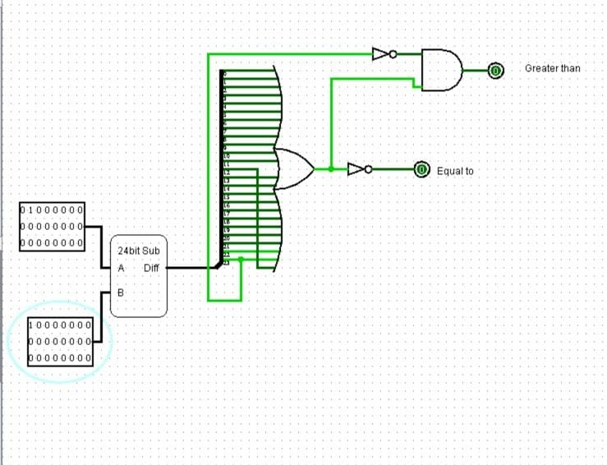
In this state of the circuit equal to flag is 0 and greater than flag is 0 too.
The difference is non 0 and the MSB is 1 as negative difference.

Slide 37
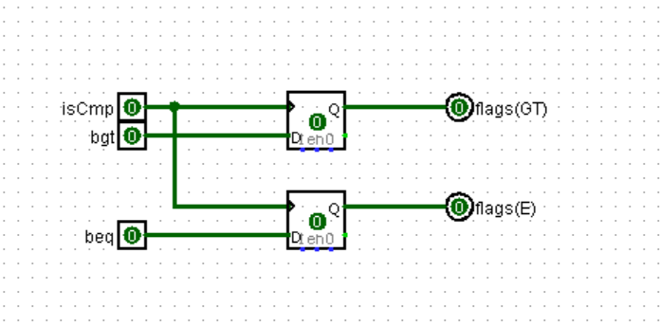
Flags
Flags E(equal to) and GT(greater than)
Takes the control signal isCmp and beq and bgt from ALU and sets the flags.

Slide 38
Cache Management
Cache management and memory read stage

Slide 39
Memory access
Executes the Load and Store instructions.
Interacts with the Main memory
Returns the data of the corresponding address.

Slide 40
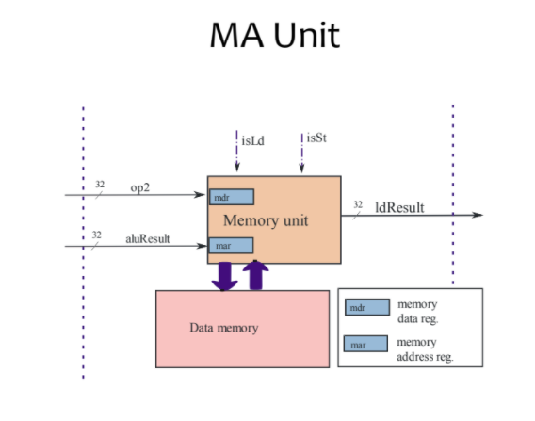
Hard Wire Implementation of Memory access

Slide 41
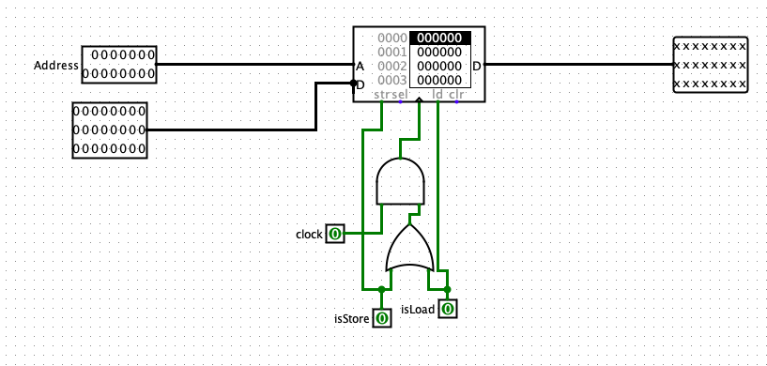
Logisim Implementation of Memory Access

Slide 42
Cache Management Techniques
We Implemented Direct map Cache Technique in the Processor.
Control instructions from the Control Unit - isLd, isStr
The Efficiency of the Processor is increased
This implementation emphasizes on the need of temporal and spatial Locality

Slide 43
Direct map Cache
This maps one block into only one possible Cache line
The address that is given is divided into 3 parts
Tag | Index | Block

Slide 44
Cache Design
Our ISA has main memory address of 15 bits i.e 2^15 memory units.
Block Size - 32 memory units
Cache Size - 16 cache entries
Tag(0-5) | Index(6-9) | block(10-14)

Slide 45
Functions of Cache
HIT - if the data is already present in the cache then it is hit, we directly load or store the data.
MISS - if the data is not present in cache then it is miss, then we go back to the main memory and fetch the data to the cache and continue the program.

Slide 46
Necessity of Replacement Techniques
No need of replacement techniques
Direct map cache maps uniquely for every index to a block
Hence the new coming block automatically replaces the existing Block

Slide 47
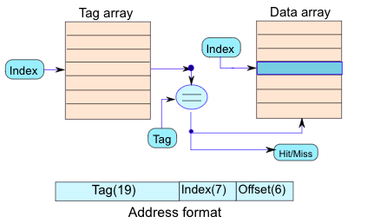
Hardwire of Direct Map

Slide 48
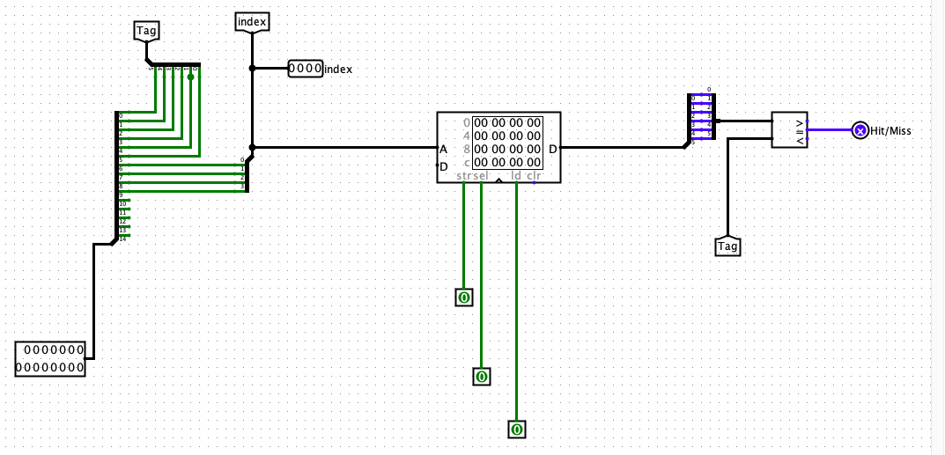
Tag Array implementation

Slide 49
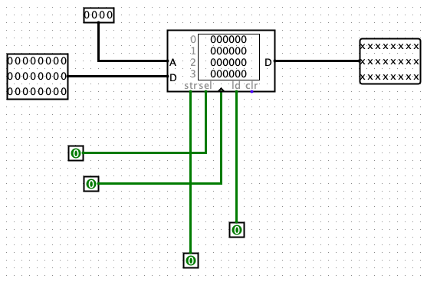
Block Array

Slide 50
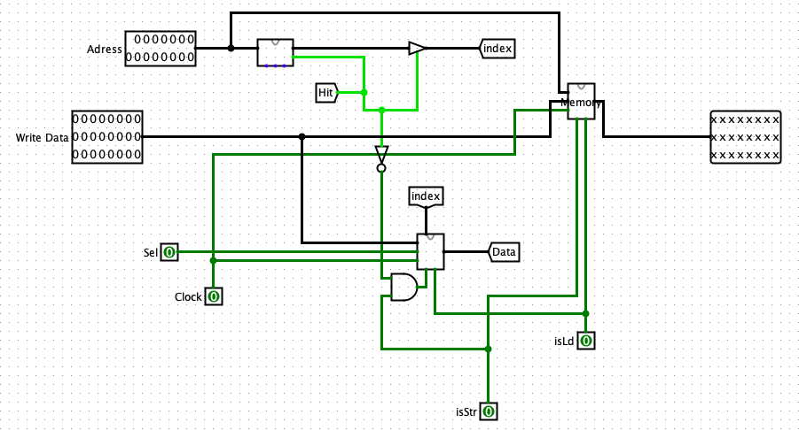
Cache

Slide 51
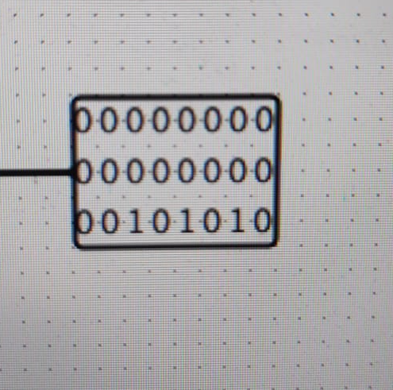
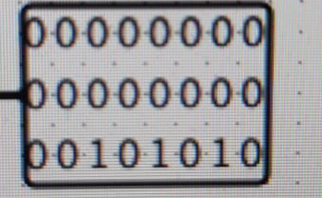
Testing of Cache

Slide 52
Testing
We tested the cache by passing same set of data for both main memory and cache it can be seen both the gave the same result confirming the expected functioning of the Cache.

Slide 53
Register Writeback

Slide 54
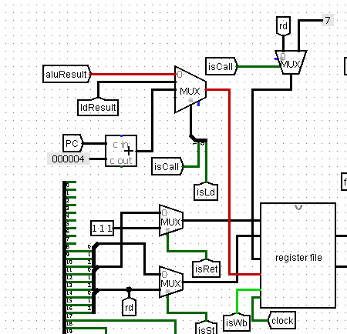
In the processor there are operations which require writing back result to the register bank. Depending on operation we have signals to decide if there is writeback required or not.
Alu operation requires writing back to destination register.
Load result requires to store data in destination register.
Call operation requires the pc address to be stored in return address register.

Slide 55
In register bank in case of writeback we need register address in which we want to store the result and the data that is required to be stored. Only when isWb control signal is active then we can write back to the register.

